Slide 1
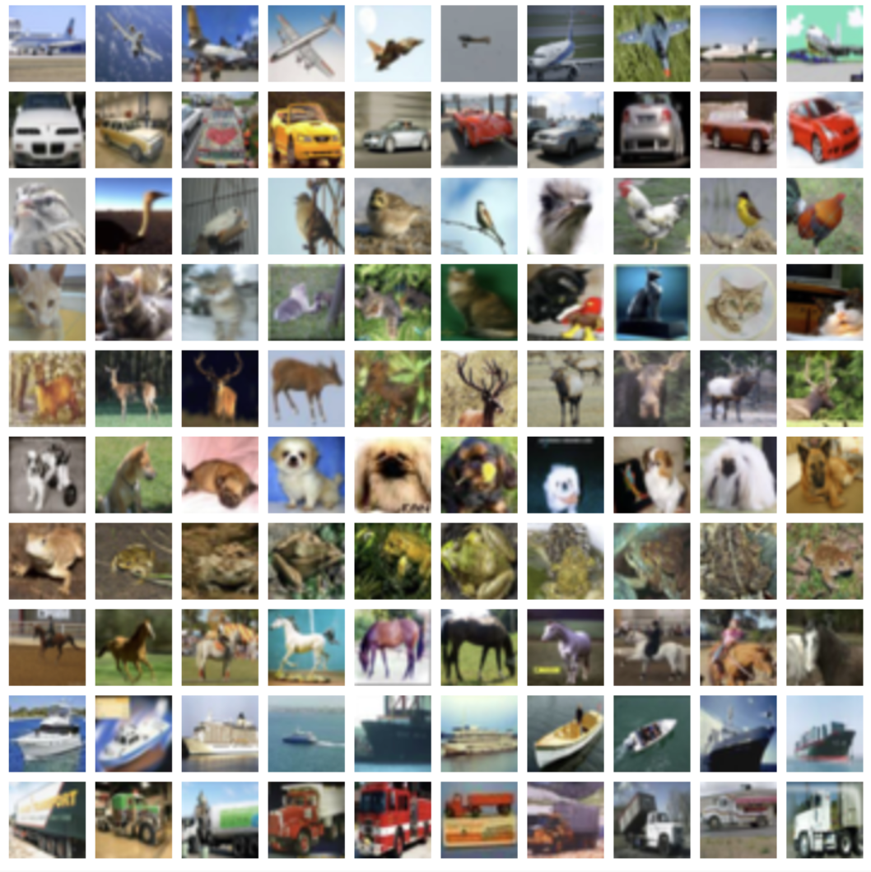
Image Classification for Object Detection
in Driverless Vehicles
Notes:
Good morning everybody, today we are going to be talking about using image classification as a pre-cursor to building highly accurate object detection software for use with driverless vehicles.

Slide 2
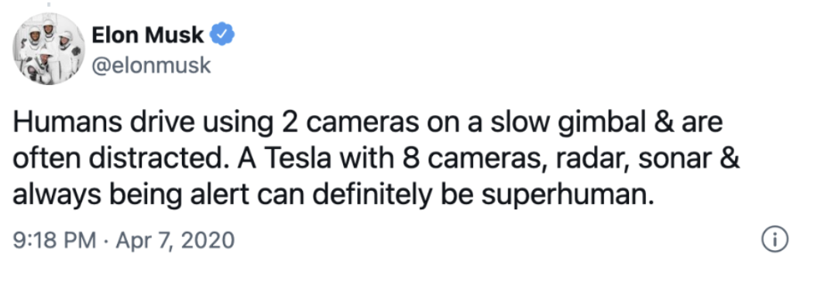
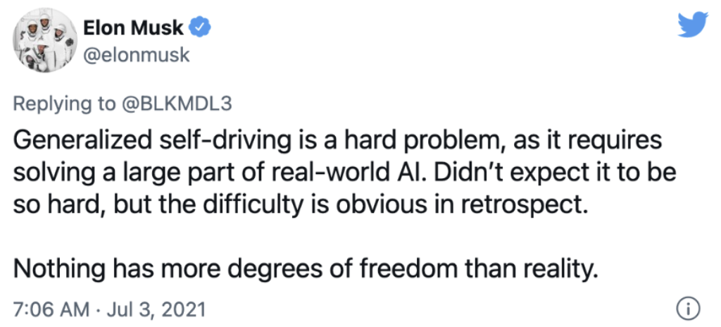
Notes:
The advantages of driverless cars can best be summarized by a tweet from one of the pioneers in this industry, Elon Musk..in which he describes driverless vehicles as being “super-human”...however the challenges are so vast that a little more than one year later, despite his outspoken optimism [NEXT] Musk proclaimed in a tweet that he never imagined that this endevour could be so difficult. Now one of the major challenges facing the industry of is object detection as the consequences of failing to correctly identify targets could be catastrophic...but even before we begin thinking about this we need to First master image classification, as this is what most object detection algorithms are built on. So we’re going to illustrate various methodologies within the realm of deep learning that could someday help make a driverless future a reality

Slide 3




CIFAR-10 Canadian Institute for Advanced Research
University of Toronto
www.cs.toronto.edu/~kriz/cifar.html
DATA
60,000 Images Colored 32x32
10 Output Labels
6,000 images/label
Notes:
The data we used in exploring this problem is a set named CIFAR-10 which is a subset of a much larger dataset maintained by the University of Toronto. It contains 60,000, 32x32 colored images, with 10 target labels and 6,000 images/label. For data acquisition and image processing we used tensorflow’s keras librar and numpy... and for data visualization we used matplotlib and seaborn

Slide 4
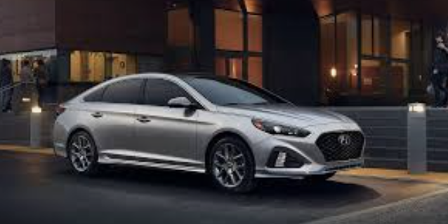
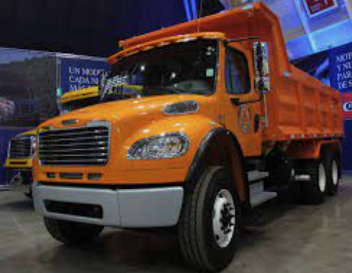
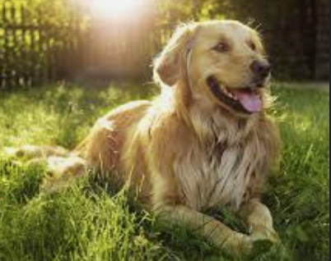
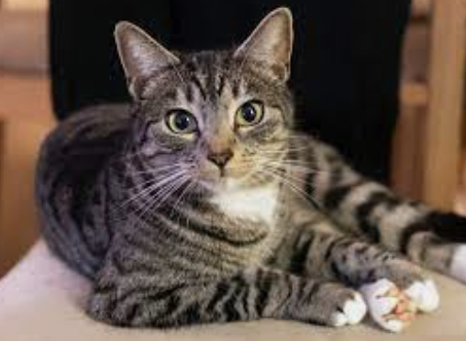
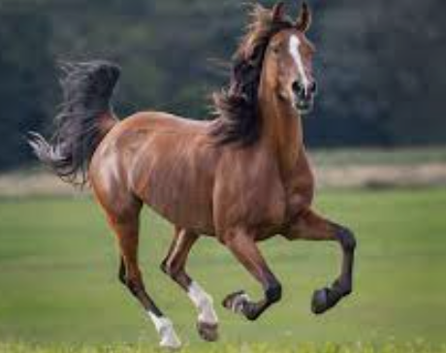
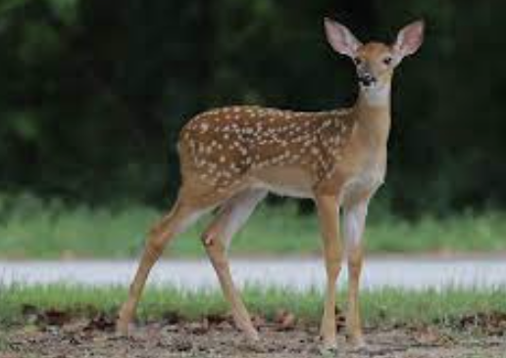
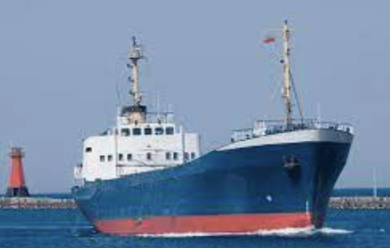
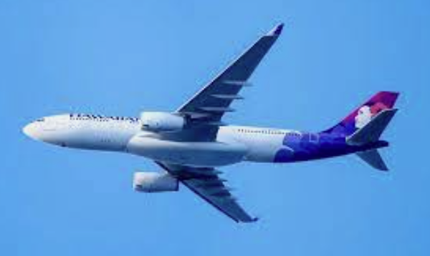
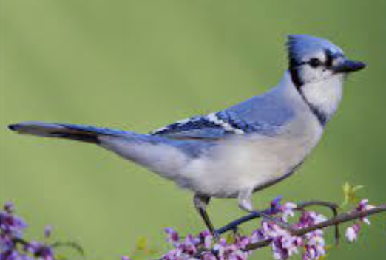
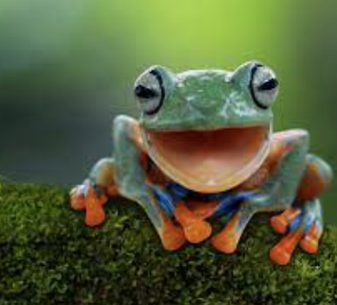
OUTPUT LABELS
“Car”
“Truck”
“Dog”
“Cat”
“Horse”
“Deer”
“Ship”
“Airplane”
“Bird”
“Frog”
Notes:
Here are our ten output labels, we’ve included objects highly likely to be found whilst driving such as cars & trucks, objects intermittently found on roads such as deer, dogs & cats and objects extremely unlikely to be encountered such ships and airplanes. We were fortunate in that the target variable was uniformly distributed amongst the classes enabling us to use easily use accuracy as metric for the overall performance of the model

Slide 5
mm
Model Experimentation
Custom Convolutional Base
Params: 2,300,940
2 Convolutional Layers
- Filters = 45, 70
2 Max Pooling Layers(2x2)
Activations = relu
2 Dense Layers
-Nodes = 750, 500
-Dropout = 0.30, 0.2
Activation = relu, softmax
0.639
Model 1
Dense Layers
-Nodes = 500,2350,125
-Dropout = .50, 20, 10
Activation = relu, softmax
0.224
Transfer Learning
With MobileNetV2
Params: 3,056,369
Frozen Convolutional Base
Imagenet
Model 2
Augmented Transfer Learning
With MobileNet V2
Params: 3,980,796
Step 1) Trained Model with frozen base
Step 2) Retrained Model:
step 1 output + dense layers
4 Dense Layer
-Nodes = 512,256,128,64
-Dropout = .30,.20,.10
Activation = relu, softmax
-
0.230
Model 3
Notes:
In terms of modeling we used the tensorflow keras library to experiment with different architectures and variations within each architecture. [NEXT} We created our first model from absolute scratch, using 2 convolutional layers, 2 max pooling layers and 2 dense layers which gave us an accuracy of 0.64 [NEXT] For our second model we employed the very popular method of transfer learning using the MobileNet V2 network, to which we added 3 fully connected dense layers which surprisingly gave us an accuracy of only 0.224, [NEXT] and for our third experiment we did something interesting...we trained the model with traditional transfer learning but then used that output to train the model again with only dense layers...this unfortunately still only produced an accuracy of 0.23. So where did we go from here?....

Slide 6
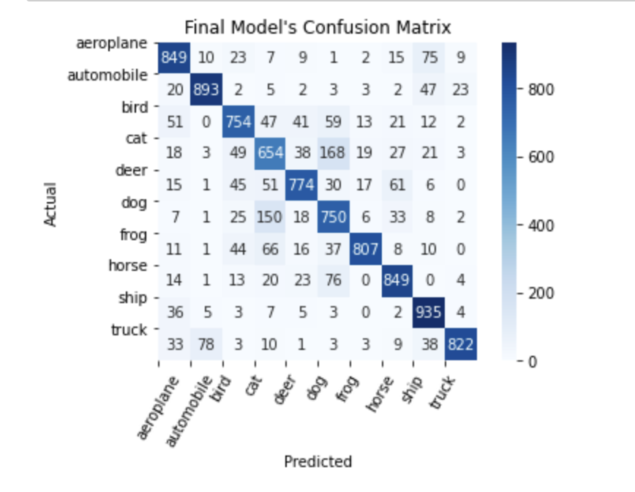
Final Model
MobileNet
Version 1
Unfreeze Base
4 Dense Layers
-Nodes: 512, 256, 128, 64
-Activation: relu,softmax
Train Model
Extract
Convolutional Architecture
0.81
Notes:
Well for our final experiment we did something antithetical to transfer learning...we unfroze the base of the MobileNet network, by doing this we for-goed all of the previously learned features and simply poached the convolutional base’s architectural shell and then applyed our custom layers to that shell..in this instance we were able to produce an incredibly improved accuracy of 0.81! This can be explained by the fact that we are training the model exclusively with the images we are attempting to predict. Now on the right we see a confusion matrix..our model appears to have done mostly a good job of correctly predicting the various classes although it does seem the categories of[NEXT} dog and cat were lagging as we predicted many dogs as cats and vice versa...and this brings up a good point in that we simply can’t look at the overall accuracy of this model..

Slide 7
Class Metrics
Precision Recall F1
Precision Recall F1
0.81 | 0.85 | 0.83
0.95 | 0.82 | 0.88
0.66 | 0.75 | 0.70
0.64 | 0.65 | 0.65
0.83 | 0.77 | 0.80
0.78 | 0.75 | 0.77
0.93 | 0.81 | 0.86
0.81 | 0.85 | 0.83
0.83 | 0.85 | 0.84
0.81 | 0.94 | 0.87
Notes:
....we need to be able to judge individual classes by the specific needs of our overall objective . For example, while driving, it’s absolutely imperative that we not create false negatives for objects we are highly likely to encounter such as[NEXT] cars and trucks and thus we would use the [NEXT] recall metric ...however when it comes objects such as[NEXT] cats and dogs we saw from our confusion matrix that the majority of misclassifications from these 2 categories were with each other, which we are actually ok with, since the car would stop in either instance, thus we might use a balanced metric [NEXT] such as f1, unfortunately its seems even here there is significant room for improvement.

Slide 8
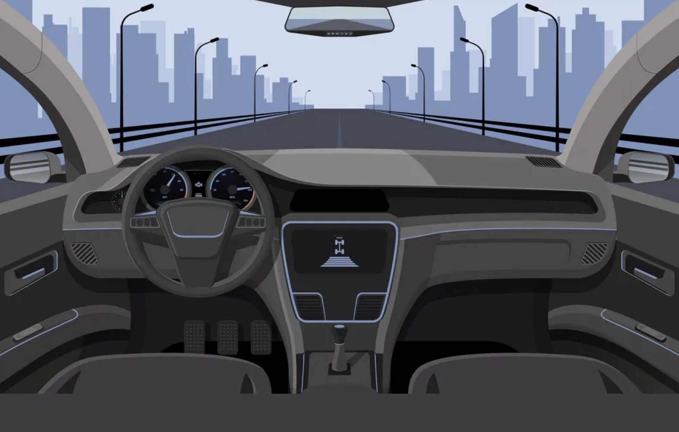
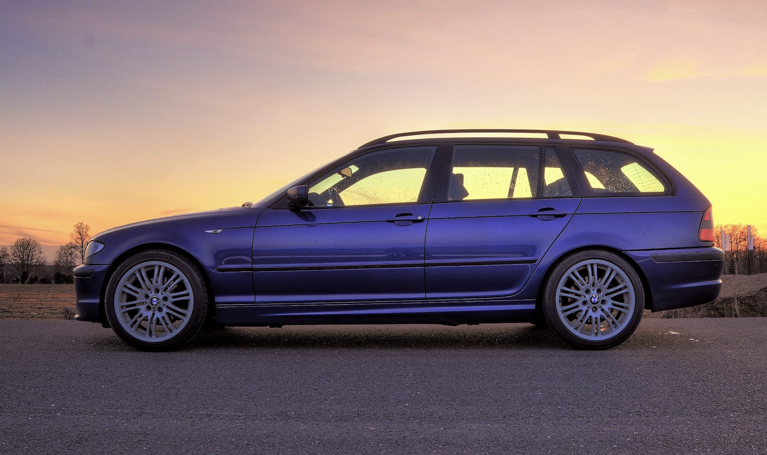
Actual: Car Predicted: Car
Notes:
So now lets test our model on random pics taken from the internet that our model has never encountered before...lets say we were driving along in our virtual car in our virtual city, not paying attention to our surrounding and all of a sudden...a[NEXT] car runs a red light crossing the street in front of you...will our model save your life? Yes in this case it does.

Slide 9
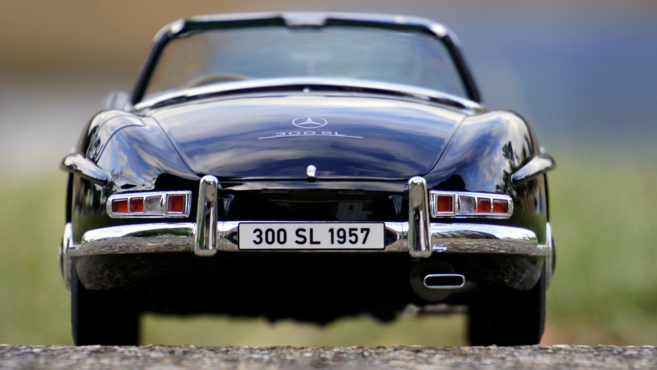
Actual: Car Predicted: Frog
Notes:
Now lets run a slightly different scenario..you are driving along, again not paying attention, and the car in front of you suddenly comes to a full stop[NEXT]..in this case does our model save you? [NEXT] no it does not, in fact it predicted a frog! So what happened here..well our model was predominately trained using pics of cars from either their side angle or front facing diagonally..there were not as many pics of the back of cars….this is why its important that we include all angles of objects in our data as well as the environment we are most likely to encounter them in.

Slide 10
FUTURE WORK
ResNet152, Xception
Image Augmentation
Images Relevant to Environment
Notes:
And finally for future work we’d like to use some other keras models such ResNet152 and Xception which are highly memory intensive but do provide greater accuracy than mobileNet. We’d also like to use more image augmentation to increase the size of our dataset...and finally we’d like to have more images of these objects on actuals roads and highways to enhance the training and accuracy of our models

Slide 11
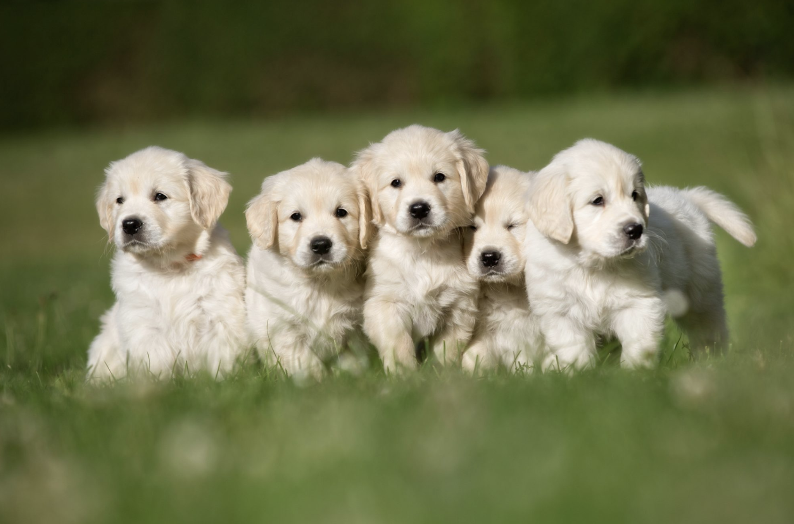
Thank you!
Notes:
And with that Im happy to take any questions

Slide 12
Appendix

Slide 13
